Slide 1
Science of Musical Instruments - Percussion
M. Ramanathan
Department of Engineering Design,
Indian Institute of Technology Madras
http://ed.iitm.ac.in/~raman/

Slide 2
Percussion instruments
musical instruments played by striking with the hand or with a stick.

Slide 3
Percussion instruments
Mridangam
Thavil
Chenda
Maddalam
Kanjira
Morsing
Tabla
Pakhawaj
HW1: Find out more
Percussion instruments.

Slide 4
Percussion
Importance of tempo / rhythm
Mridangam – King of Percussion

Slide 5
Sample carnatic concert
Play sample concert 1 – Mine
Play sample concert 1 – Mandolin
Play sample concert 2 – M.S.
Tabla and Thavil also has been used – esp. by Srinivas

Slide 6
History
Mentioned in Ancient sanskrit texts and Ajanta caves
Brahma as an accompanying Taala instrument while Lord Paramashiva wa dancing after Thripura samharam
was first played by Lord Ganesha?
Lord Nandi (the Bull God), the escort of Lord Shiva was a master percussionist (during Taandav).

Slide 7
Rhythm
Esp. in carnatic music – allows innovations and variations
Shruti Mata Laya Pita

Slide 8
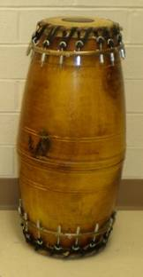
Parts of mridangam
Jack tree or Rosewood
Left, middle and right
Left – Rava mixed with water is used.
Right – Meetu and Chappu skins.
Karanai – mixture of manganese powder, rice and iron powder
Strips connecting the two.

Slide 9
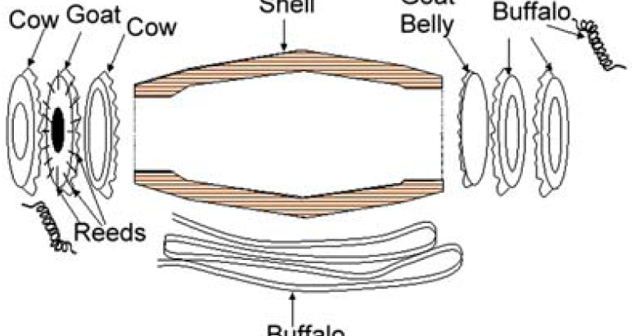
Detailed Parts

Slide 10
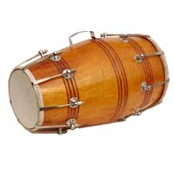
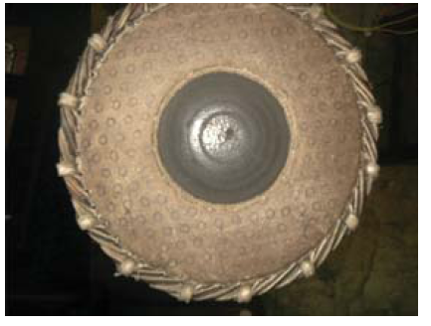
Dholak

Slide 11
Mridangam Making
Show demo
MridangamMaking

Slide 12
Variations in mridangam
Large/smaller right diameter, length. Dia inversely proportional to pitch.
Thagu Shruthi (24 to 26 in. and dia 6.5 to 7.5) and the other is Sthaayi Shruthi (20 to 22 in., and dia. 6 to 7).
Kuchi (used typically by Sivaraman, vellore Ramabhadram) – with slender grass pieces that are inserted for better sound quality, which kappi does not have (mostly K. Mani, Raghu, TK Moorthy uses)

Slide 13
Kuchi/Kappi Demo
Play Videos of Kuchi/Kappi

Slide 14
Thanthi Mridangam
Play the video of Thanthi

Slide 15
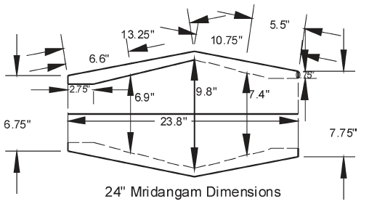
24in Mridangam

Slide 16
Thaalam
Tool for measuring the tempo and also to some extent the structure of the song.
Maintaining the rhythm or the beats of a song constant.
Reflects the mood of that song.

Slide 17
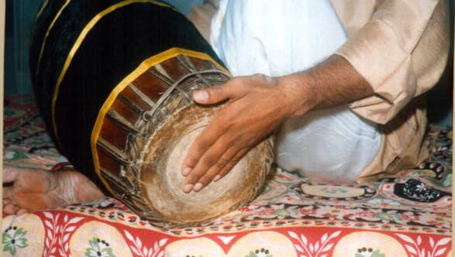
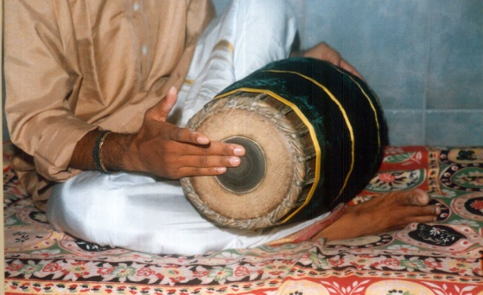
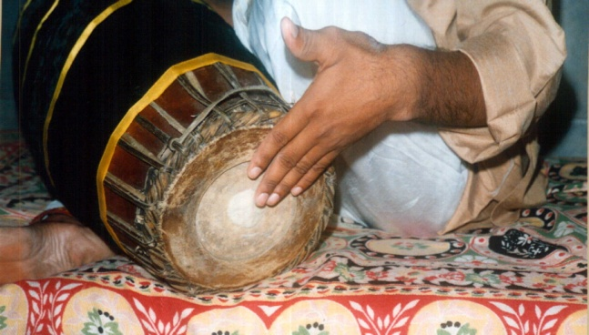
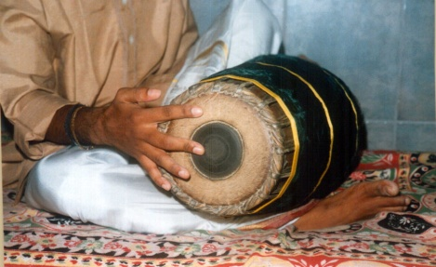
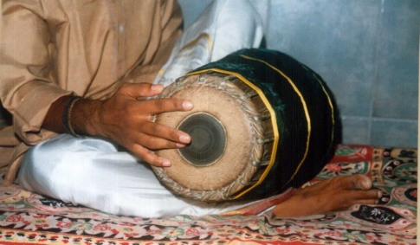
Basic strokes of Mridangam
Tha, Thi, Thom, Nam (Palani and Tanjore)

Slide 18
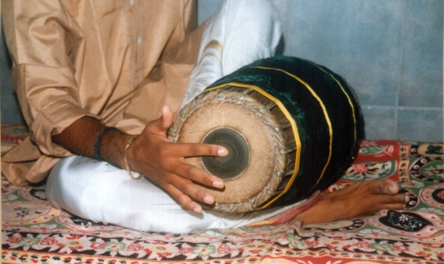
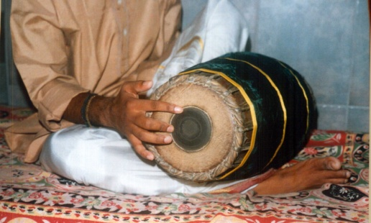
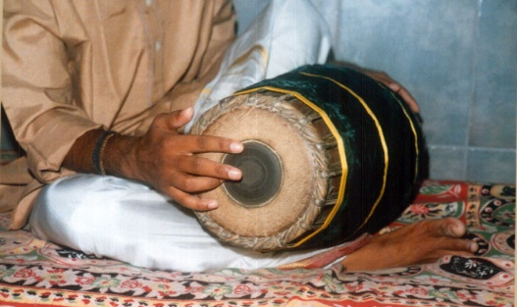
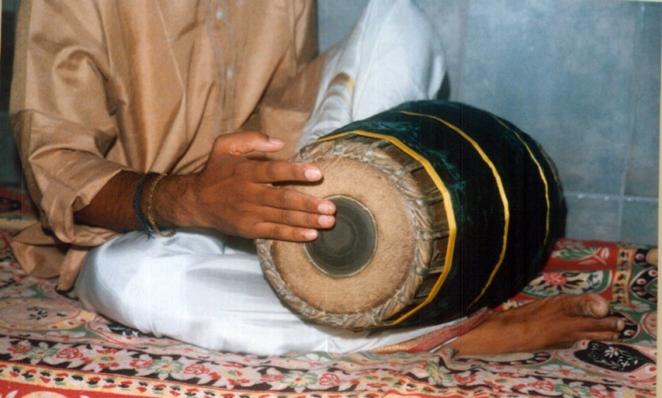
Basic strokes of Mridangam
Ta, Dhim, Chappu – Full, Half

Slide 19
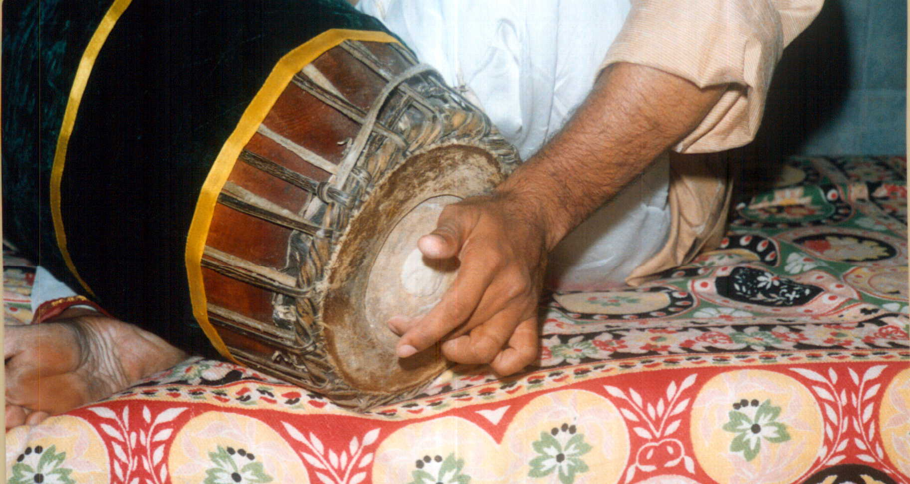
Strokes of Mridangam
Using Gumki on the left, one can create different sounds.

Slide 20
Sound from a Drum
Easy to distinguish the sound of a drum from a string instrument (why?)
A sound has a definite pitch if it is periodic (waveform repeats itself).
Sound from a drum decays very fast.

Slide 21
Strings vs Drums
Strings and drum membranes can vibrate freely.
There exist special modes of vibration with simplest periodic motion – a simple harmonic or sinusoidal motion (normal modes)
Any arbitrary vibration can be decomposed into a superposition of normal modes.

Slide 22
Fundamental and overtones
Lowest normal mode is called fundamental
Higher frequencies are called overtones.

Slide 23
Harmonics
an overtone accompanying a fundamental tone at a fixed interval, produced by vibration of a string, column of air, etc. in an exact fraction of its length.
a component frequency of an oscillation or wave

Slide 24
Harmonics (Contd)
A harmonic is a signal or wave whose frequency is an integral (whole-number) multiple of the frequency of some reference signal or wave. The term can also refer to the ratio of the frequency of such a signal or wave to the frequency of the reference signal or wave.
For a signal whose fundamental frequency is f , the second harmonic has a frequency 2 f , the third harmonic has a frequency of 3 f , and so on

Slide 25
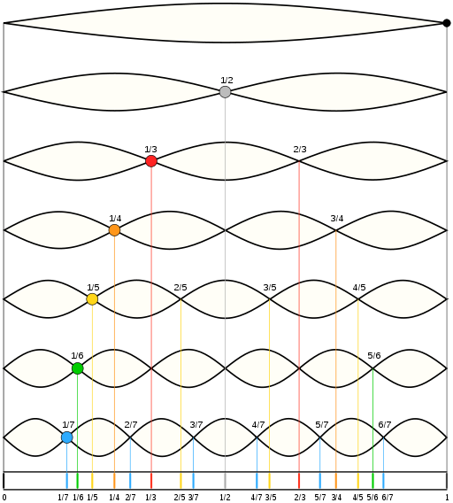
Nodes of a vibrating string

Slide 26
What happens in strings?
Essentially, all the overtones are integer multiples of the fundamental (harmonics)
Superposition of sine waves in integer ratios will always give periodic waveforms.

Slide 27
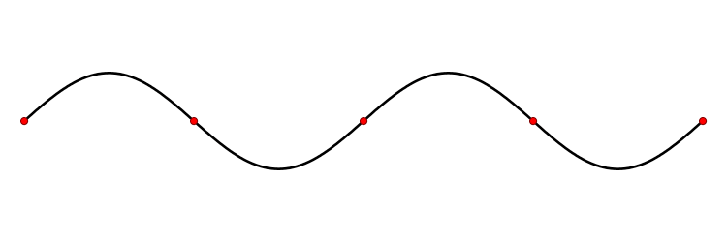
Node
A node is a point along a wave where the wave has minimum amplitude.

Slide 28
Percussion Instruments
Circular Membrane.
Frequencies produced by a uniform circular membrane are not harmonic (ratios are not rational numbers).
Inharmonic and hence musically defective! (according to Sir C. V. Raman)

Slide 29
Circular Membrane
mode shapes of a circular membrane, the nomenclature for labelling the modes is (d,c) where d is the number of nodal diameters (lines) and c is the number of nodal circles.
A node is a point (or line) on a structure that does not move while the rest of the structure is vibrating.
Nodal diameters and circles show up as white regions that don't oscillate, while the red and blue regions indicate positive and negative displacements.

Slide 30
Mode shapes (Circular membrance)
http://www.acs.psu.edu/drussell/Demos/MembraneCircle/Circle.html

Slide 31
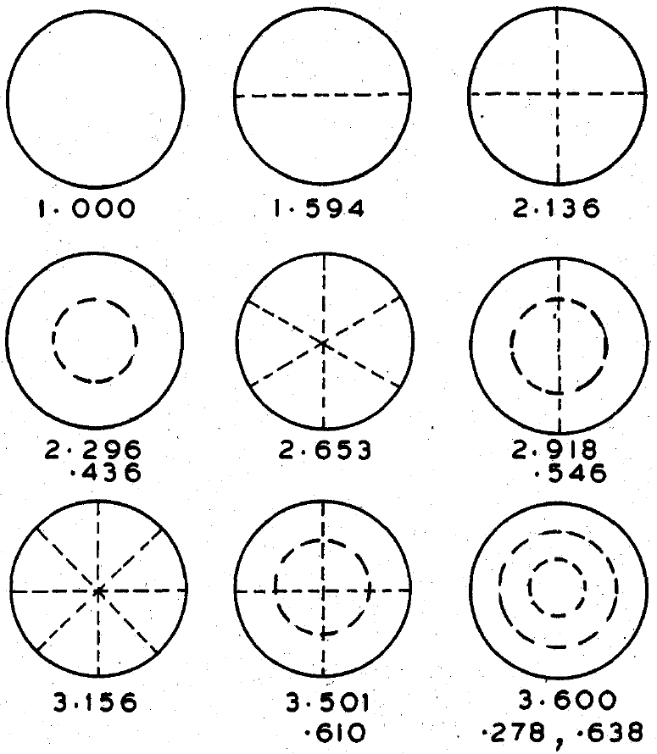
Normal modes of uniform membrane

Slide 32
Mridangam
Stands apart, used for high class chamber music (`noise’ of other percussion instruments would be intolerable)
Circular membrane, but harmonic.

Slide 33
Mridangam Construction
Two sided drum played with both hands
Heavy hollow wooden shell
On both sides, three-sets of leather being used.
Hoops are then put over the leather.
Connected by strips, that adjusts the tension as well as providing uniform tension.

Slide 34
Right side of Mridangam
Three layers of skin
Two are rings (why?)
Only one ring is visible (obvious by now!)
Loaded symmetrically with a firmly adherent composition – finely divide iron-oxide, charcoal, starch, gum.

Slide 35
Contd
Layer by layer, rubbing with a smooth piece of stone or metal.
Thickness is greatest at the center and shades down towards the margin.
Thickness and distribution are determined by testing the tone of the drum continuously during the process.

Slide 36
Acoustic characteristics
Sustained ones – heavy wooden shell and then symmetrical loading
Loading of the drum increases the energy of vibration (enclosed air within the shell is another)
Width of the ring – damping effect and hence tone adjustment (suppresses high tones)

Slide 37
Construction of drum-head seeks to arrange the first nine normal modes of the membrane into a harmonic sequence of five tones.
Eliminate existence of normal modes at higher pitch (achieve by appropriately sized ring).

Slide 38
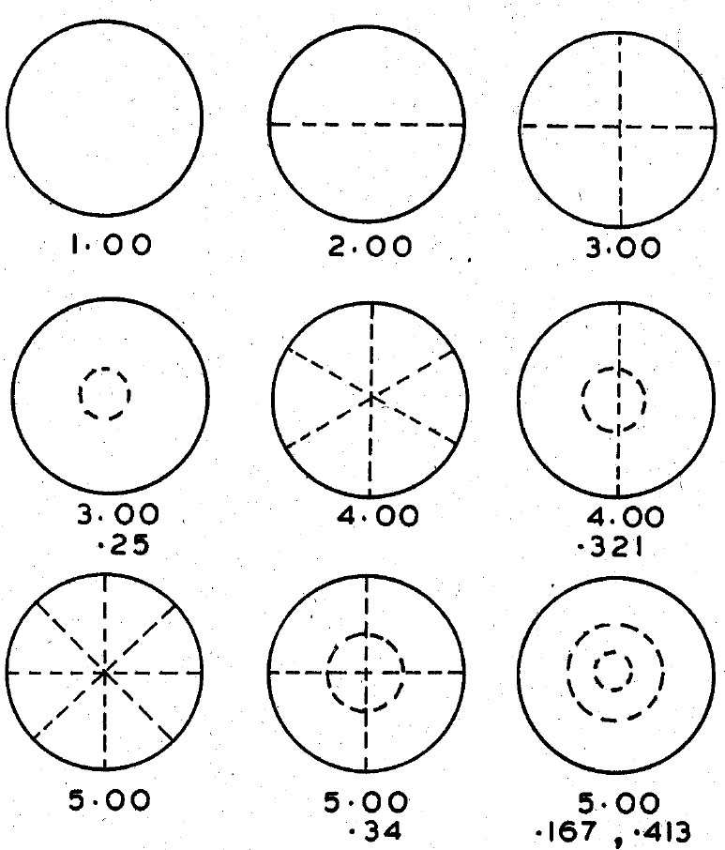
Normal Modes of Harmonic drum

Slide 39
Five tones of the drum
Mridangam demonstration

Slide 40
Material
Jackwood
Palmyrah
Red Sanders
Siamese cassia

Slide 41
Properties
Low density
Medium hardness for machining
Good sound radiation coefficient (SRC)

Slide 42
Parchments
Cow-based (fibre bundles are higher ~85 microns)
Goat-based (~25 microns) (highest strength for a given thickness). Goat skin also provides the highest compaction and tensile strength.
Parchments from limed goat skin are the best.

Slide 43
Black patch
Number of layers.
FFT analysis of Dheem (fundamental) 01, Chappu (2nd harmonic) 11 and Num (3rd harmonic) 21
Meetu/Chappu = 1.5 (1.38 to 1.5)
Dheem/Chappu = 0.5 (0.66 to 0.535)

Slide 44
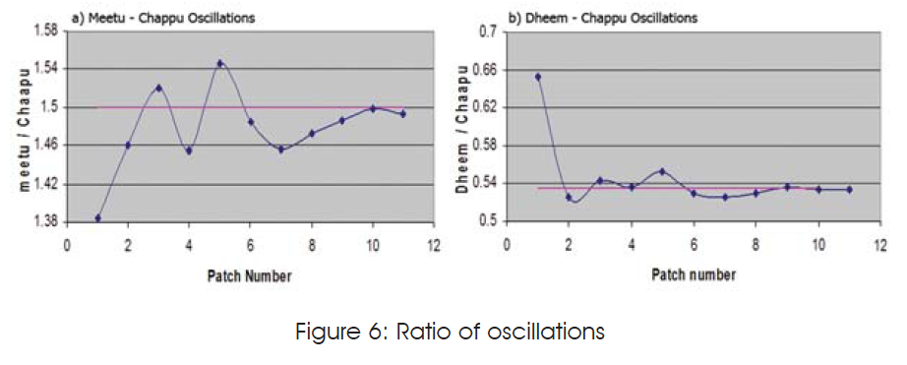

Slide 45
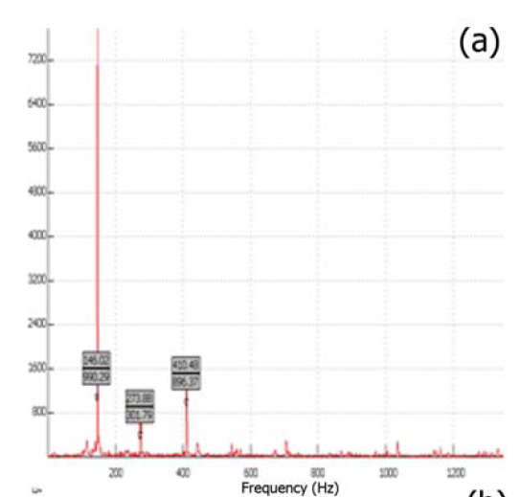
Mridangam Strokes using FFT - Dheem
Prominent peaks at 146 and 410.
Mridangists tune at 275 (2nd harmonics).
Dheem is 1.07 of the fundamental (hence 0.535)

Slide 46
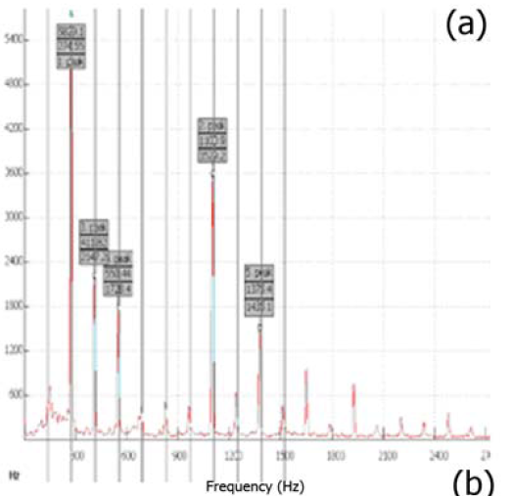
Chappu
Prominent peaks at 275 and 1100

Slide 47
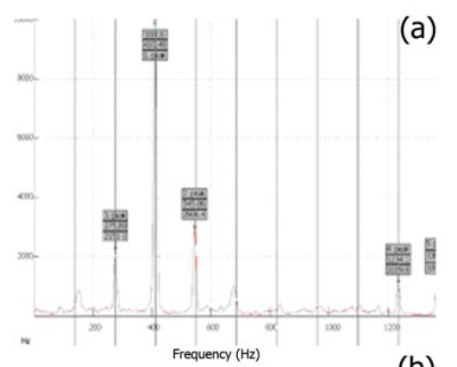
Meettu
Most prominent at 410, 1.5 times the second harmonic

Slide 48
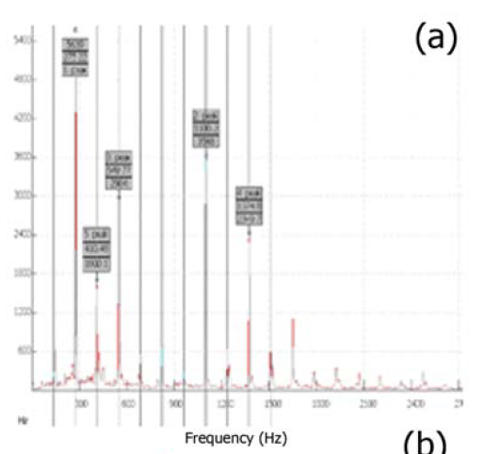
Arachappu
Prominent peaks at 275, 550 and 1100 – 2nd, 4th, and 8th harmonic frequencies.

Slide 49
Harmonic sequence
Dheem, Chappu, Meettu, Arachappu – 1.07, 2nd, 3rd and 4th harmonic frequencies.
Tuning done at 2nd harmonics.

Slide 50
Fusing cultures
Scientists – Measure, discover, standardize, calibrate
Artists – Feel, Create, differentiate, set standards.
Fused – Discover to create, feel to measure, differentiate to standardize, Set standards to calibrate.

